Slide 1
August 29, 2016
Good morning/afternoon ☺ Happy Monday! Outside work pgs. 5-8 are due today.
Get out your Comparative Advantage Practice Sheet and something to make corrections with.
Please grab a DARK GREEN McConnell Textbook from my bookshelf near the door and get out your notes.
HW: Review your circular flow notes – quiz tomorrow.

Slide 2
Specialization and Trade
Absolute and Comparative Advantage

Slide 3

Specialization
Our world is interdependent – countries rely on the success of other countries for the success of their own.
Because the United States is a part of an open economy that includes the international sector, the US produces more of some goods than others.

Slide 4
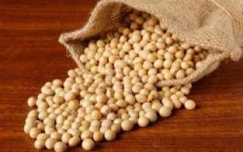
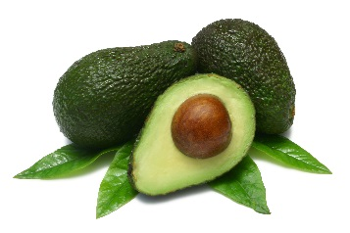
Specialization
Specialization and trade allows for trade to increase the productivity of a nation’s resources and allows for greater total output (the making of more stuff) than would otherwise occur.
  When a country specializes, they can utilize their resources more effectively and maximize output and it reduces the cost of obtaining goods and services that a nation desires.
In essence – specialization is simply more economically desirable and productively efficient.

Slide 5
Voluntary Exchange
Because not every nation is an expert at producing everything, they often try to work together and trade with each other to get more of the products they desire at a least cost to them.
This is the idea of voluntary exchange – participating in an open economy and trading resources in order to maximize production and meet demands.
Let’s watch a clip on voluntary exchange to better understand how trading and specialization works.

Slide 6

Common Sense Economics – Stossel Voluntary Exchange

Slide 7
Absolute and Comparative Advantage
In order to determine what products a nation should specialize in, they utilize comparative and absolute advantage.
These are important concepts to understand and they help businesses and nations understand what to produce and what to trade for.

Slide 8
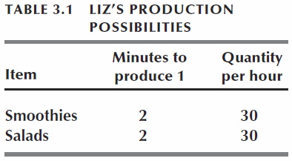
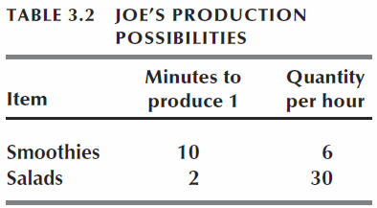
Absolute & comparative advantage
  Absolute advantage is a situation in which one person (nation) is more productive than another person (nation) in several or even all activities.
  Who can make the most?
  Example: Liz and Joe.
  Each hour, Liz splits her time equally between smoothies and salads and produces 15 smoothies and 15 salads.
    Each hour, Joe spends 50 minutes producing smoothies and makes 5 smoothies. In the other 10 minutes, he produces 5 salads.
  Who has absolute advantage?
  Should Liz produce both smoothies and salads?

Slide 9
comparative advantage
  Comparative advantage is the ability of a person (nation) to perform an activity or produce a good or service at a lower opportunity cost than someone else.
  Who can make it for less/more efficiently?
  Nations and people should trade based off of comparative advantage, not absolute advantage. This leads to specialization and makes both trade partners better off. This is the basis for specialization and voluntary trade.
  Comparative advantage is calculated by determining opportunity cost at the extremes or at the specialization points.
  This is done through the input method or output method.

Slide 10
Input vs. Output Methods
If you are calculating comparative advantage of outputs (goods) – you use the “other goes over” formula. The “other good” is the numerator, and the original good is the denominator.
If you are calculating comparative advantage in inputs (time) – you use the “other goes under” formula. The “other good” becomes the denominator and the original good is the numerator.

Slide 11
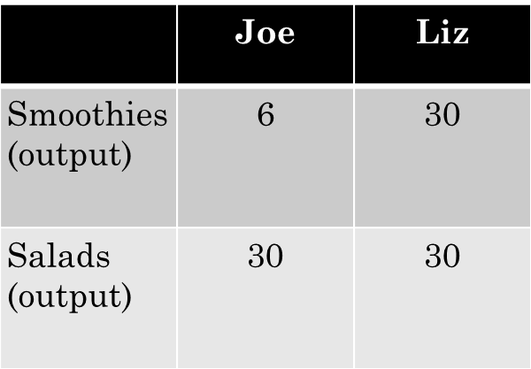
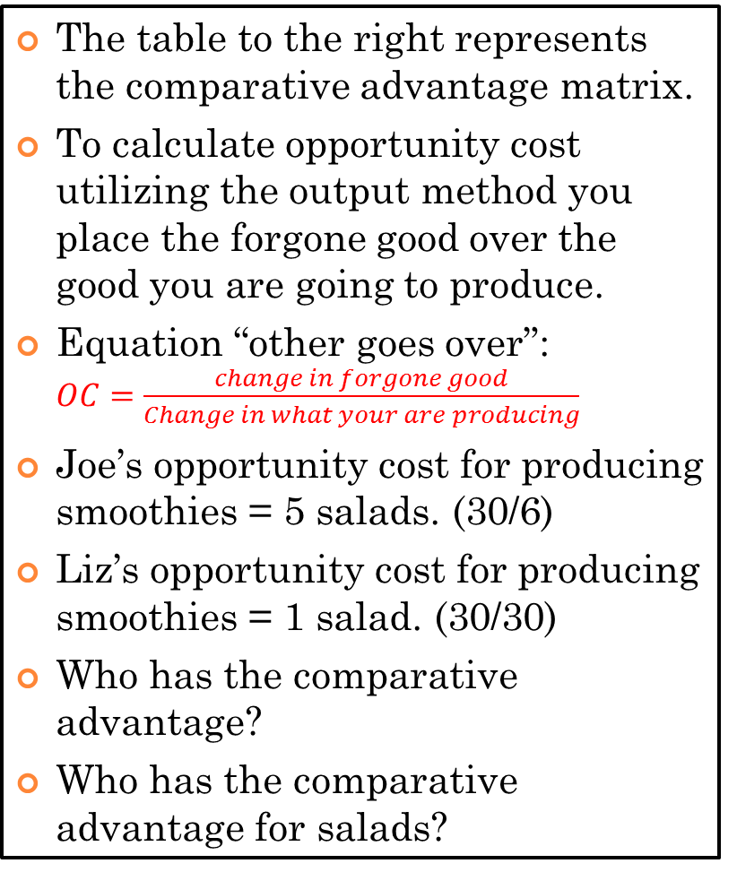
Comparative advantage – output method
The table to the right represents the comparative advantage matrix.
To calculate opportunity cost utilizing the output method you place the forgone good over the good you are going to produce.
Equation “other goes over”: $OC=\frac{change in forgone good}{Change in what your are producing}$
Joe’s opportunity cost for producing smoothies = 5 salads. (30/6)
Liz’s opportunity cost for producing smoothies = 1 salad. (30/30)
Who has the comparative advantage?
Who has the comparative advantage for salads?

Slide 12
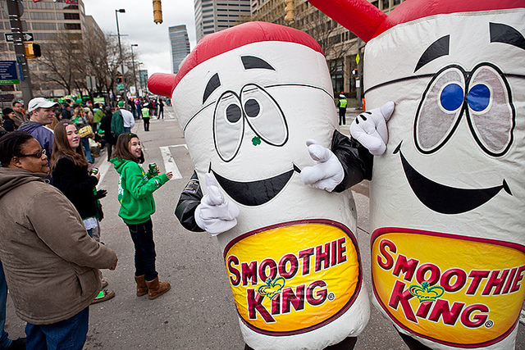

Who has the comparative advantage?
  Liz’s Comparative Advantage: Liz’s opportunity cost of a smoothie is less than Joe’s, so Liz has a comparative advantage in producing smoothies.
  Joe’s Comparative Advantage: Joe’s opportunity cost of a salad is 1/5 smoothie, Liz’s is 1 smoothie. Joe has the comparative advantage in producing salads.

Slide 13
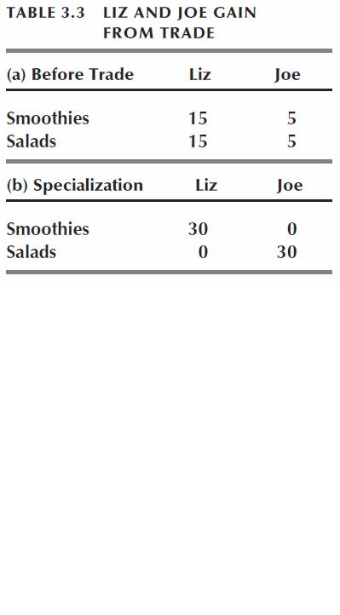
DID LIZ and Joe benefit?
Based on the previous findings Liz and Joe specialize in the good which they possess the comparative advantage in.
Original production is adjusted to fit their specialization. Do they benefit?

Slide 14
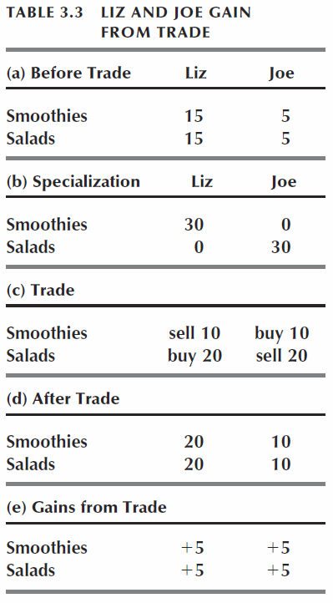
Specialization and trade
Liz sells Joe 10 smoothies and buys 20 salads.
Liz has 20 salads and 20 smoothies, Joe has 10 salads and 10 smoothies.
Gains from trade:
    Liz gains 5 smoothies and 5 salads an hour.
    Joe gains 5 smoothies and 5 salads an hour.

Slide 15

Mr. Clifford

Slide 16


Comparative advantage – scenario 1
Hogwarts sweatshop
 | Brooms (max output) | Wands (max output)
Gryffindor | 20 | 10
Ravenclaw | 18 | 12
Using the Comparative Advantage Matrix to the right. Calculate the opportunity cost for specialization in each product.
Who has the comparative advantage in brooms?
Who has the comparative advantage in wands?

Slide 17
Comparative advantage – scenario 2
Japan vs. U.S.A.
Use the PPF on the left to create a comparative advantage matrix and answer the following questions:
Who has absolute advantage in cars?
Who has absolute advantage in computers?
What is each countries opportunity cost for cars?
What is each countries opportunity cost for computers?
What should each country specialize in? Why?
CARS
12
10
COMPUTERS
4
6
Japan’s PPF is in orange.
USA’s PPF is in black.

Slide 18

Comparative advantage – input method
Jedi Master Burgess
Beyond utilizing the output method, comparative advantage can be determined through what is referred to as the input method.
Input method is based on time, i.e. it takes Mr. Burgess six minutes to produce one lightsaber, it takes him 10 minutes to produce one blaster. Mr. Burgess’ apprentice Yoda takes 5 minutes to produce one lightsaber and 12 minutes to produce one blaster.
 | Minutes to produce 1
Lightsaber | 6
Blaster | 10
Jedi Master Yoda
 | Minutes to produce 1
Lightsaber | 5
Blaster | 12

Slide 19

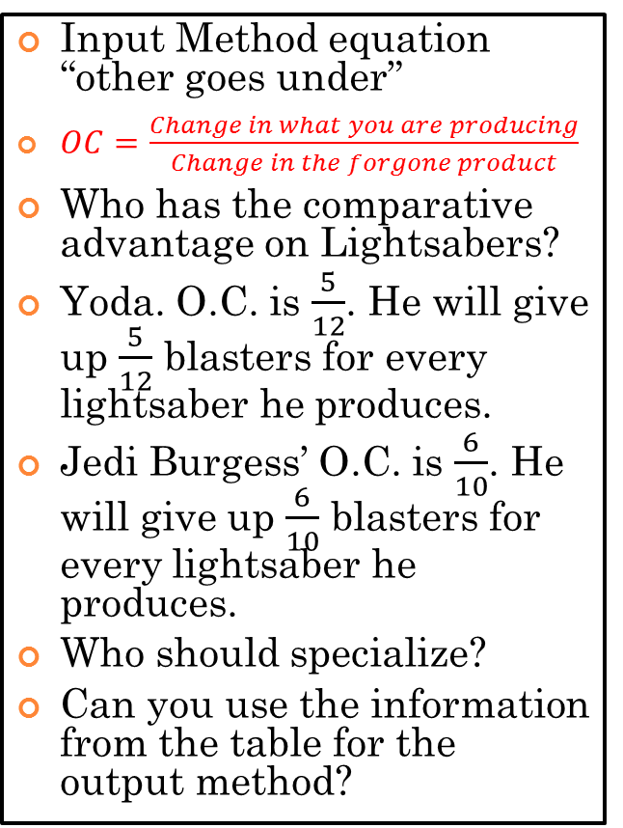
Comparative advantage – input method, cont’d
Jedi Master Burgess
Input Method equation “other goes under”
$OC=\frac{Change in what you are producing}{Change in the forgone product}$
Who has the comparative advantage on Lightsabers?
Yoda. O.C. is $\frac{5}{12}$. He will give up $\frac{5}{12}$ blasters for every lightsaber he produces.
Jedi Burgess’ O.C. is $\frac{6}{10}$. He will give up $\frac{6}{10}$ blasters for every lightsaber he produces.
Who should specialize?
Can you use the information from the table for the output method?
 | Minutes to produce 1
Lightsaber | 6
Blaster | 10
Jedi Master Yoda
 | Minutes to produce 1
Lightsaber | 5
Blaster | 12

Slide 20
PRODUCTION POSSIBILITIES
Curve For Each Country
United States
Brazil
Who has the
Comparative advantage for coffee? Wheat?
45
40
35
30
25
20
15
10
5
0
30
25
20
15
10
5
0
Coffee (tons)
Coffee (tons)
A
B
5 10 15 20 25 30
5 10 15 20
Wheat (tons)
Wheat (tons)

Slide 21
PRODUCTION POSSIBILITIES
Principle of Comparative Advantage
Total output will be greatest when
each good is produced by the nation
that has the lowest domestic
opportunity cost for that good.
U.S has comparative advantage in wheat.
Brazil has comparative advantage in coffee.

